Slide 1
Virtual Reality

Slide 2
Group Members
Matt Kalafut – History, Evolution
Jordon Kopp – Science and Technology, Psychology
Vince Smeraldo – Art, Education
Josh Kopp – Business
Derek Finch – Future

Slide 3
Introduction
Virtual reality
An advanced form of human-computer interfaces that will immerse the user in a computer-generated world that allows user interaction

Slide 4
Thesis
Virtual reality is an emergent technology that is bringing forth advancement to many fields including entertainment, simulations, and realistic virtual environments.

Slide 5
History and Evolution

Slide 6
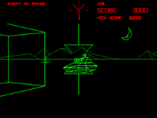
Early History & Tech
Dates back to the 1920s (“Who Invented VR?” 2009)
Started as vehicle simulation
Extremely primitive
Basic Shapes
Image: (Battlezone, n.d.)

Slide 7
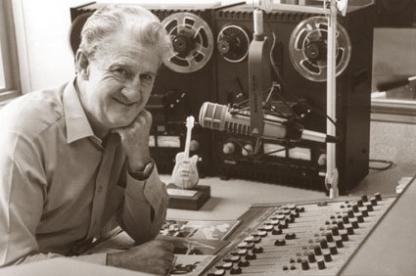
Who Invented It?
Controversy over actual creator
Evolved from several various technologies
Many contributors
Officially Morton Heilig
Widely accepted as official inventor
Image: (TimeRime, 2010)

Slide 8
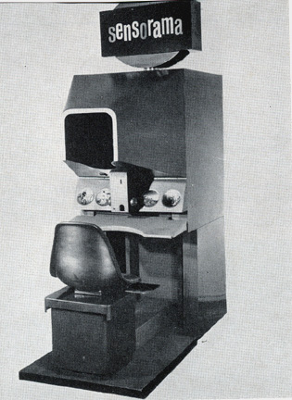
Sensorama
Idea originated in 1950s (Saquete, 2010)
1962 – Sensorama prototype invented
Image: (Ferragallo, n.d.)

Slide 9
Sensorama
Large machine
TV screens, fans, other machinery
Displayed 5 short films
“Engaged sight, sound, smell, touch” (“How did VR begin?, n.d.)

Slide 10
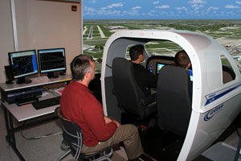
Traditional Virtual Reality
Sensorama had others thinking
Unsuccessful
Lead to advanced technology
Virtual reality of today
Designed in 1966 by Thomas Furness III (HITL, n.d.)
Flight simulator
Airforce training
Image: (GTC, 2008)

Slide 11
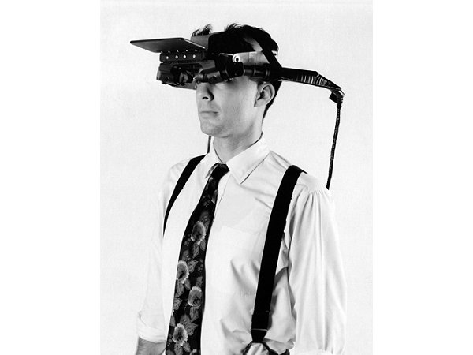
Where It’s Gone
Head-mounted Displays (HMD)
Used to enhance experience
“The beginnings of VR” (Bilawchuk, n.d.)
Image: (Computer History Museum, n.d.)

Slide 12
Where It’s Gone
Invented by Ivan Sutherland
Created in 1968
First head mounted display
3D wire-frame explorable room (CHM, n.d.)

Slide 13
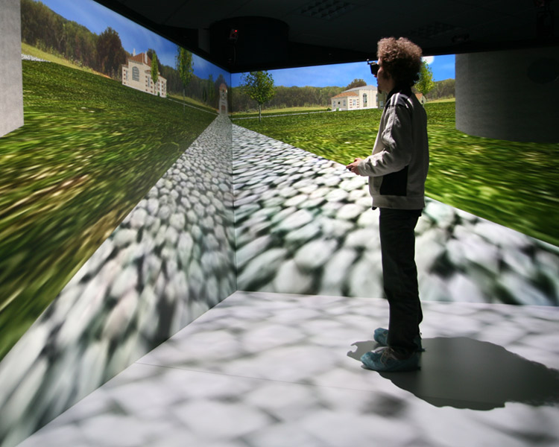
How It’s Evolved
Started as wireframes and basic shapes
Eventually utilized images and video
Going even further
Full 3D immersion
Augmented reality
Realistic user experience
Image: (Antycip Simulation, n.d.)

Slide 14
Science and Technology

Slide 15
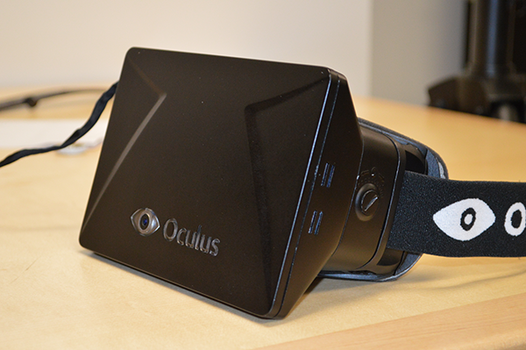
Head-mounted Displays
Display types (Virtual reality displays, n.d.)
Fiber-optic
Virtual retinal
Plasma
Light emitting diode (LED)
Image: (Orland, 2012)

Slide 16
Head-Mounted Displays
Audio
Headphones
Speakers

Slide 17
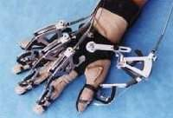
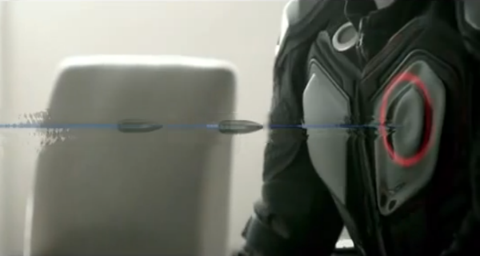
Human-machine Interface (HMI)
Gloves (Virtual reality gear, n.d.)
Bodysuits (Virtual reality gear, n.d.)
Image: (Bley, 1999)
Image: (Virtual reality technology , n.d.)

Slide 18
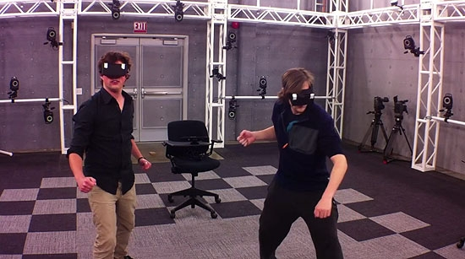
Tracking Systems
Head tracking (“Virtual reality tracking systems”, n.d.)
Position tracking (“Virtual reality tracking systems”, n.d.)
Image: (Wong, 2012)

Slide 19
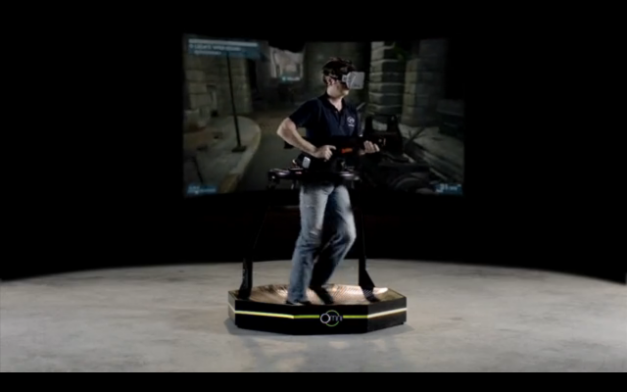
Systems
Oculus Rift (“Oculus VR”, n.d.)
Head tracking
LED display
Other technologies (“Oculus VR”, n.d.)
Omnidirectional treadmill
Haptic suit
Gun controllers
Image: (Wong, 2013)

Slide 20
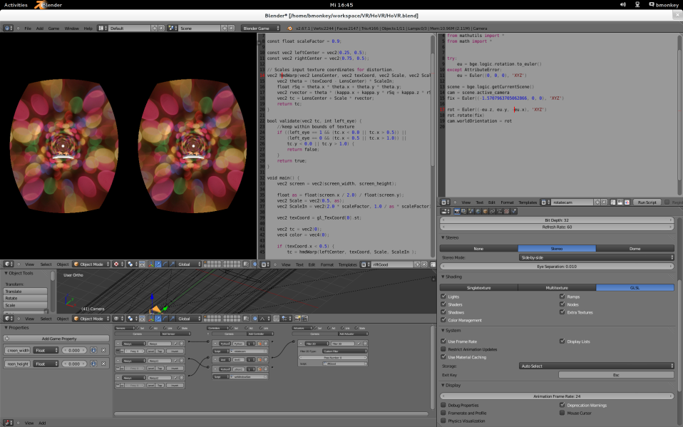
Systems
Development
Software development kit (SDK) in development
Existing SDKs adding Oculus Rift functionality
Unreal Engine
Unity Engine
Blender Engine
Image: (“Oculus”, 2013)

Slide 21
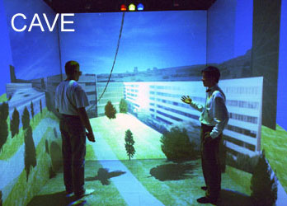
Systems
CAVE (Creagh, 2003)
Head tracking
Position tracking
Other technologies (Creagh, 2003)
Head-mounted display
HMI gloves
Image: (Forget, 2012 )

Slide 22
Art

Slide 23
Art
Virtual vs. real
New level of immersion
Can create new objects

Slide 24
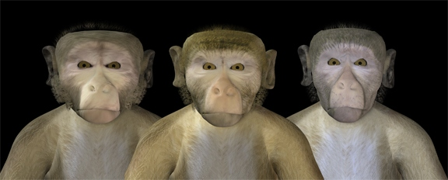
Virtual Vs. Real
“Uncanny Valley”
Uneasiness when not real
Image: (Steckenfinger, 2009)

Slide 25
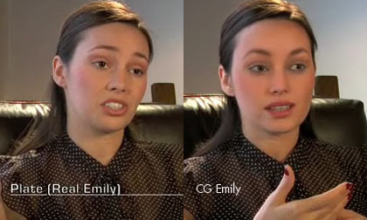
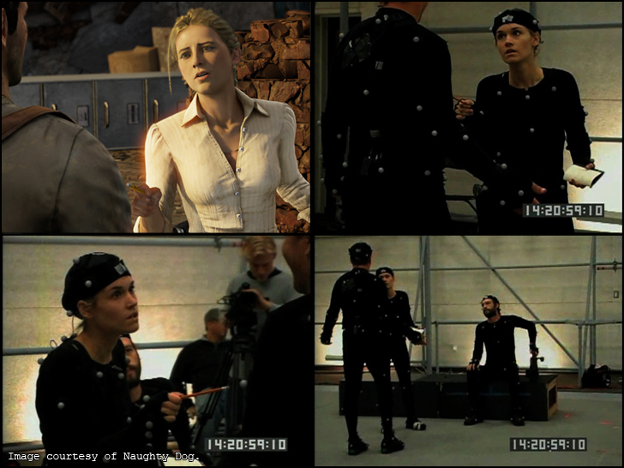
Virtual Vs. Reality
Blurring the lines
Better renderings
Motion capture
Image: (Amidi, 2008)
Image: (Mocap, n.d.)

Slide 26
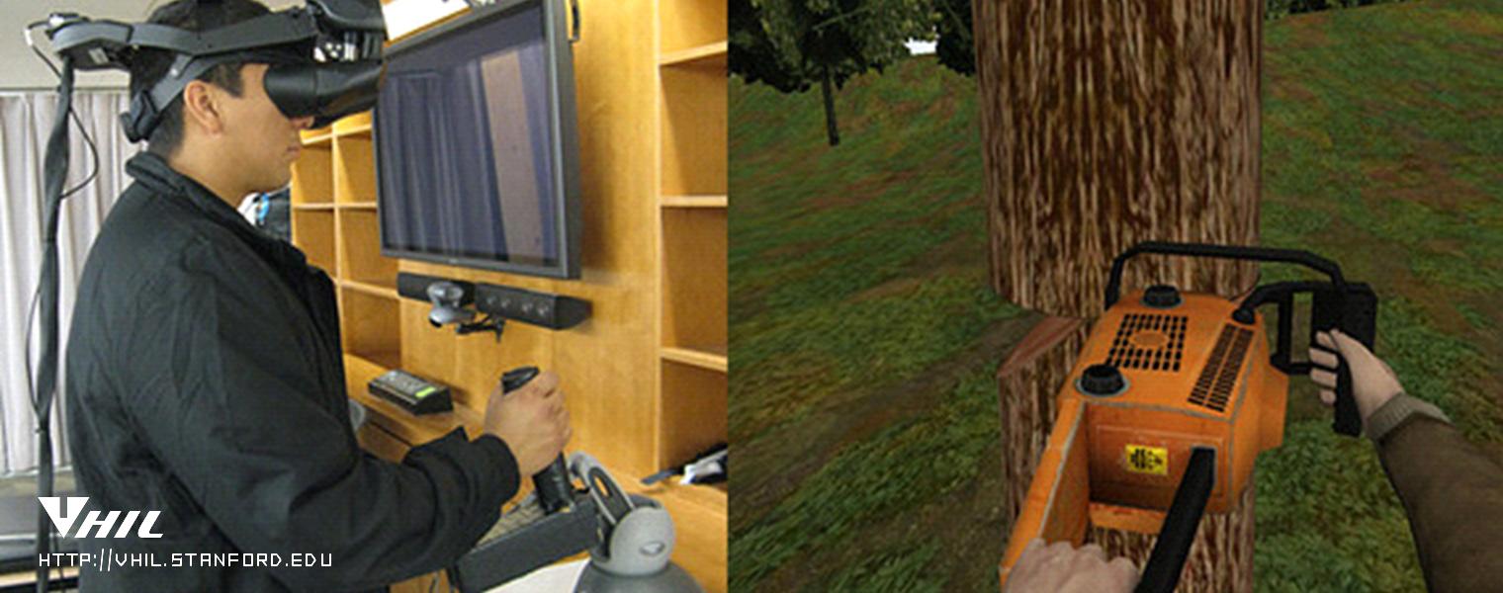
Immersion
“Dive” into a world
Can interact with virtual objects
Image: (Using, n.d.)

Slide 27

Create New Objects
Architects can design houses that may never be built
Image: (Woodland, n.d.)

Slide 28
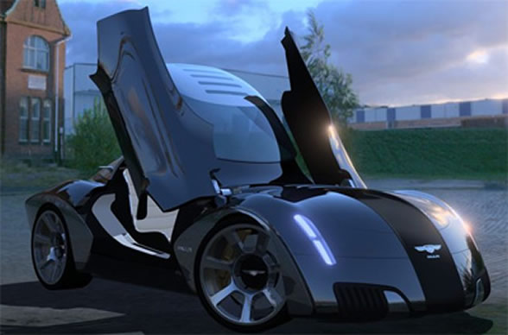
Create New Objects
Designers can create cars that may never go into production
Image: (Paulin, 2011)

Slide 29
Education

Slide 30
Education
Hands-on training
New perspectives
Safe training

Slide 31
Hands-on Training
Gain experience in controlled environment
“Participants reported that they learned better, enjoyed the experience more, and thought the virtual teacher was more credible in VR than in video”(Bailenson et al, n.d.)

Slide 32
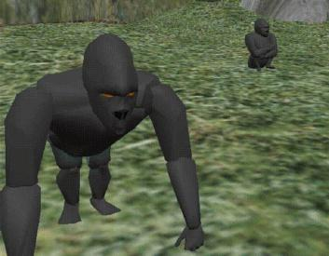
New Perspective
Virtual gorilla exhibit
View gorilla behavior first-hand
See facial expressions
Interact with gorillas
Image: (Virtual, n.d.)

Slide 33
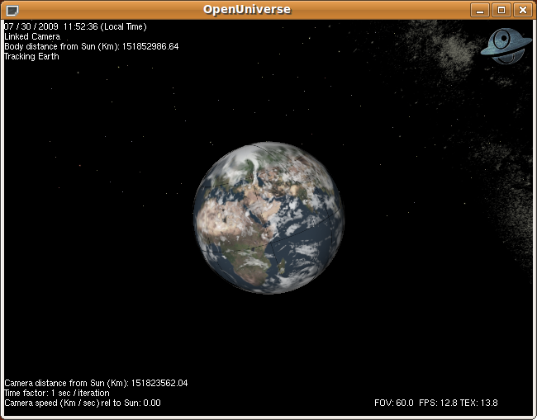
New Perspective
Space simulations
Explore galaxies
Understand relations between bodies in space
Image: (Explore, n.d.)

Slide 34
Safe Training
Eliminates risk
Reset tests quickly
Easily create multiple scenarios
Review performance

Slide 35
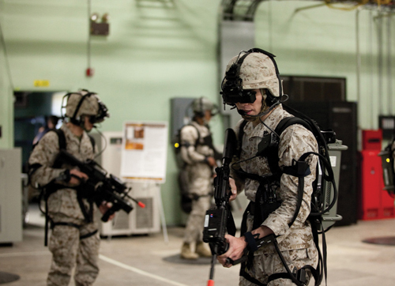
Safe Training
Military simulations
Image: (Parsons, 2012)

Slide 36
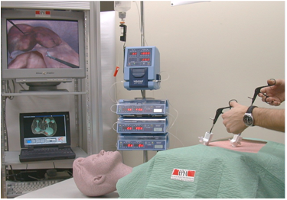
Safe training
Surgical simulations
Image: (Surgical, n.d.)

Slide 37
Business

Slide 38
Cost Savings
Cost to build virtual reality lab: $2,000,000 (Hannah, 2007)
Cost to use lab for the day: $1,000 (Hannah, 2007)

Slide 39
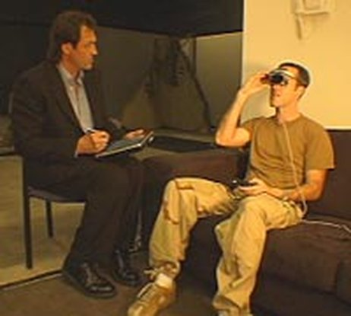
Cost Savings
Navy saves nearly $115,000 for every 12 patients treated using Virtual Reality (Wood, 2009)
Image: (Jardin, 2005)

Slide 40
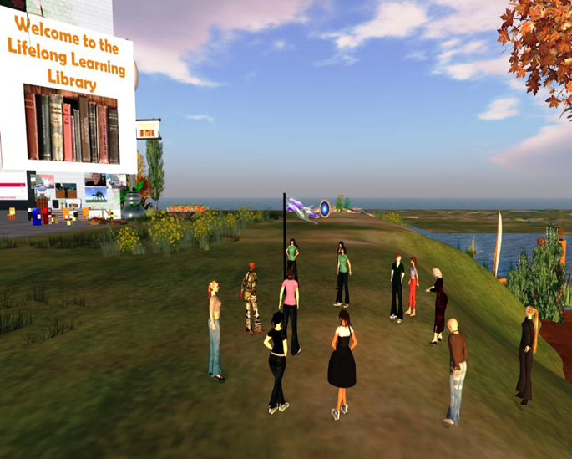
Cost Savings
“The cost of a virtual event compared with a physical one is close to 90 per cent less”(Southan, 2011)
Image: (Hill, 2013)

Slide 41
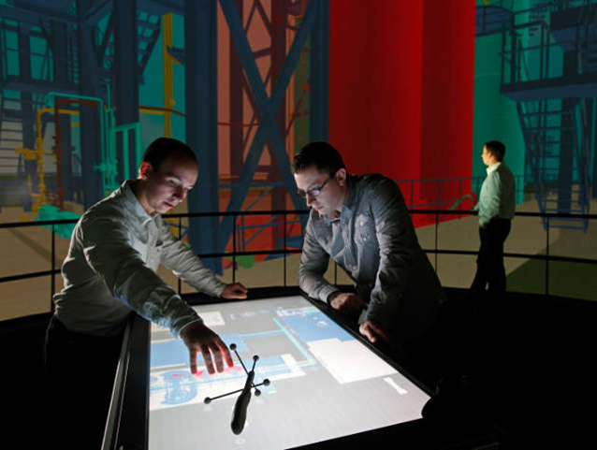
Potential Increased Profits
Better training from virtual reality (HPINNOVATIONS, 2011)
Testing for oil (Hannah, 2007)
Image: (Beciri, 2012)

Slide 42
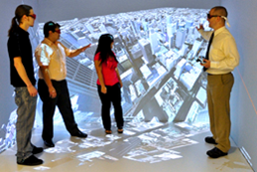
Cost of Systems
CAVE : $500,000 (Welcome, 2013)
Oculus projected under $300 (Jackson, 2013)
Image: (Welcome, 2013)

Slide 43
Psychology

Slide 44
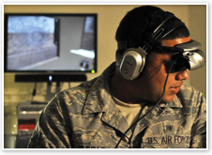
Treatment and Therapy
Post-traumatic Stress Disorder (PTSD) (McIlvaine, 2011)
Training
Desensitization
Parkinson’s (Elsevier Health Sciences, 2011, July 12)
Image: (Virtual reality aids, n.d.)

Slide 45
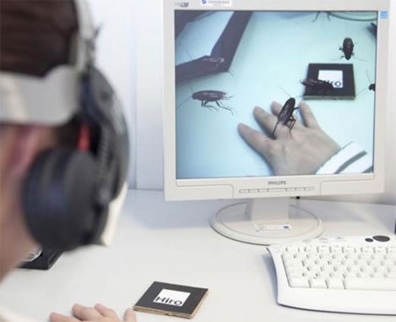
Treatment and Therapy
Strokes (Aron, 2012)
Phobias
Exposure therapy
Stress
Image: (Bugged , n.d.)

Slide 46
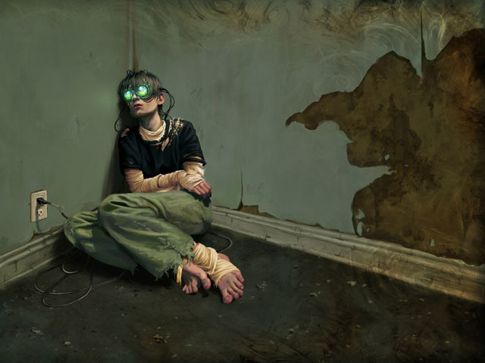
Ethics
Desensitization (Ethical issues, 2013)
Cyber addiction (Ethical issues, 2013)
Virtual criminality (Beardon, C., 1992)
Image: (A dark view, 2006)

Slide 47
Future

Slide 48

Future Applications – Architecture and Construction
Clients visit virtual buildings (Briggs, 1996)
Homes
Experience
Fragrances
Textures
Sounds
Avoid costly changes
Image: (Schmelzer, 2009)

Slide 49
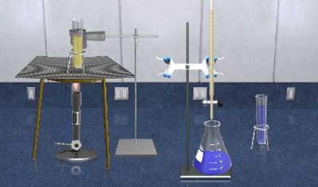
Future Applications – Education
Conduct science experiments safely (Briggs, 1996)
Study galaxies through travel
Interaction with fictional characters
Image: (Rivero, 2012)

Slide 50
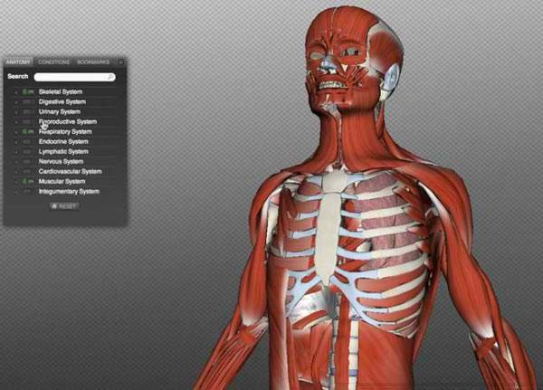
Future Applications – Medicine
Less dangerous (Briggs, 1996)
Virtual human body dissection
Procedural testing
Disease simulation
Image: (Darma, 2012)

Slide 51
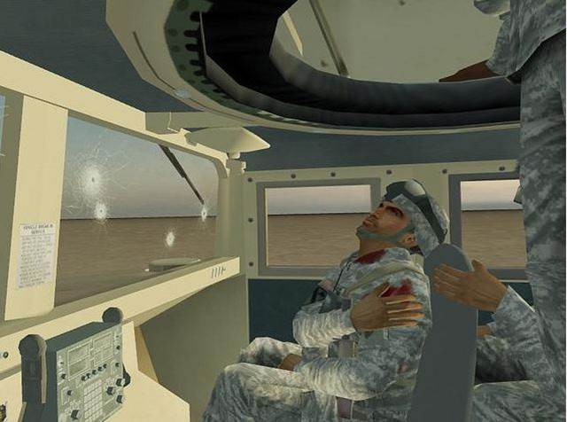
Future Application – Military
Simulation practice (Briggs, 1996)
War scenarios
Conflict resolution
Make decisions and see outcome
Image: (Military training, n.d.)

Slide 52
Artificial Life – Constraints
More natural world to user (Luck, & Aylett, 2000)
High frame rates – realism
Polygon count must decrease
Virtual environment toolkits incapable of real physics

Slide 53
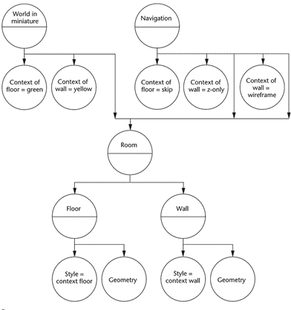
Artificial Life - Constraints
Scene graph traversal is slow
Image: (Schmalstieg, et al., 2007)

Slide 54
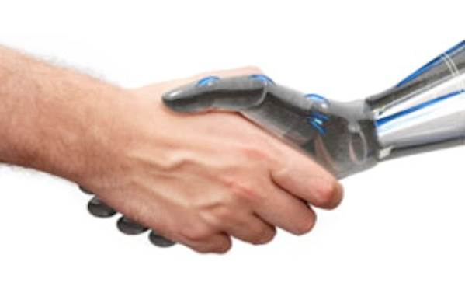
Artificial Life – Autonomous Agents
Perform dynamic roles (Luck, et al., 2000)
Envision human everyday life
React to the environment
Virtual sensors to learn from actions
Image: (Atkinson, et al., n.d.)

Slide 55

Human Mind Uploading – Human Continuation
Cyborgs will be a reality (Botz-Bornstein, 2012)
Replace brain location with machine
Problems
Eternal life
No needs
Emotionless unless programmed
Image: (Posel, 2012)

Slide 56

Human Mind Uploading – Live in the Virtual World
Live virtually (Bhojane, 2012)
Scan mind, upload, 3D model
Ageless
Limitations
Developer dictated
Physics
Life/death
Image: (Niiler, 2013)

Slide 57
Conclusion
Virtual reality brings forth many new possibilities that were never available before, especially in major fields that require simulated environments.

Slide 58
References
A dark view into the future of game addiction. (November 2, 2006). MAVAV. Retrieved from http://www.mavav.org/2006/11/02/a_dark_view_into_the_future_of_ga me_addiction.php
Amidi, A (2008, Aug 19) Revisiting the uncanny valley. Cartoon Brew. Retrieved from http://www.cartoonbrew.com/cgi/revisiting-the-uncanny-valley- 6551.html
Aron, J. (2012). Brain training for stroke recovery. New Scientist, 214(2863), 17.
Atkinson, D., Clark, M., & Venable, B. (n.d.). Autonomous agents lab. Florida Institute for Human & Machine Cognition. Retrieved from http://www.ihmc.us/groups/datkinson/wiki/107cd/
Bailenson, J, Kayur, P, Nelson, A, Bajsky, R, Jung, S, Kurillo, G (n.d.) The effect of interactivity on learning physical actions in virtual reality. Media Psychology. Retrieved from http://vhil.stanford.edu/pubs/2008/bailenson-mp-interactivity.pdf
Battlezone. (n.d.). International Arcade Museum. Retrieved from http://www.arcade-museum.com/game_detail.php?game_id=7059

Slide 59
References
Beciri, D. (2012, July 3). Virtual development and training - Platform for production facilities. Robaid. Retrieved from http://www.robaid.com/tech/virtual-development-and-training- platform-for-production-facilities.htm
Bhojane, S. S. (2012). Computer research on human mind uploading in fiction. Golden Research Thoughts. 1 (7), p. 1-3. Retrieved from Academic Search Complete.
Bilawchuk, A. (n.d.) Where did VR come from? Virtual Reality. Retrieved from http://www.bilawchuk.com/mark/history.html
Bley, F. (1999). Virtual reality technology. Fbley. Retrieved from http://www.fbley.de/index.htm
Botz-Bornstein, T. (2012). Critical posthumanism. Pensamiento Y Cultura. 15 (1), pp. 20-30. Retrieved from Academic Search Complete.
Briggs, J. C. (1996). The promise of virtual reality. Futurist. 30 (5), p. 13. Retrieved from MasterFILE Premier.

Slide 60
References
Bugged Out: Augmented reality insects help beat phobia. (n.d.). Gajitz. Retrieved from http://gajitz.com/bugged-out-augmented-reality- insects-help-beat-phobia/
Darma, S. (2012, January 13). Medical students to wear 3D glasses for anatomy class? MedGadget. Retrieved from http://www.medgadget.com/2012/01/medical-students-to-wear- 3d-glasses-for-anatomy-class.html
Ebersole, S. (1997). A brief history of virtual reality and its social applications. University of Southern Colorado. Retrieved from http://faculty.colostate- pueblo.edu/samuel.ebersole/336/eim/papers/vrhist.html
Elsevier Health Sciences (2011, July 12). Parkinson's disease patients may benefit from virtual-reality-based therapies. ScienceDaily. Retrieved from http://www.sciencedaily.com­/releases/2011/07/110711104928.htm
Ethical issues for the use of virtual reality in the psychological science. (2013). Ethical Issues of VR. Retrieved from http://www.virtuallybetter.com/af/documents/VR_Ethics_Chapter.p df

Slide 61
References
Ferragallo, R. (n.d.). The Sensorama. Ferragallo . Retrieved from http://www.ferragallo.com/sensorama.html
Forget the red pill. (March 26, 2012). Could this happen. Retrieved from http://couldthishappen.com/?p=373
FRASCA True-flight flight training device. (2008, Nov 17). Gateway Technical College. Retrieved from http://mainweb.gtc.edu/InterDev/page.asp?q=691&pid=10-402-1
Goertzel, B. (2007). Human-level artificial general intelligence and the possibility of a technological singularity: A reaction to Ray Kurzweil’s The Singularity Is Near, and McDermott’s critique of Kurzweil. ScienceDirect. 171 (18), pp. 1161-1173. Retrieved from http://www.sciencedirect.com/science/article/pii/S0004370207001464
Hannah, J. (2007). Use of virtual reality spreading in business world. USA Today. Retrieved from http://usatoday30.usatoday.com/tech/news/techinnovations/2007-01- 15-virtual-reality-business_x.htm

Slide 62
References
Hill, V. (2013). 3D Sci-fi library exhibit in Inworldz. Valibrarian. Retrieved from http://vhill.edublogs.org/category/virtual-reality/
How did virtual reality begin? (2009) Virtual Reality Blog. Retrieved from http://www.vrs.org.uk/virtual-reality/beginning.html
HPINNOVATIONS. (2011). Hydrocarbon Processing , 90(5), pp. 25-28. Retrieved from Academic Search Complete.
Jackson, J. (2013, Aug. 7). Computer game pioneer John Carmack joins virtual reality startup. Chief Information Officer Magazine. Retrieved from http://www.cio.com.au/article/523109/computer_game_pioneer_john_ carmack_joins_virtual_reality_startup/
Jardin, X. (2005, Aug. 19). Virtual reality therapy for combat stress. National Public Radio. Retrieved from http://www.npr.org/templates/story/story.php?storyId=4806921
Luck, M., & Aylett, R. (2000). Applying artificial intelligence to virtual reality: Intelligent virtual environments. Applied Artificial Intelligence. 14 (1), p. 3- 32. doi:10.1080/088395100117142

Slide 63
References
McIlvaine, R. (2011). Virtual-reality games helping with PTSD. Soldiers, 66(4), 24. Retrieved from Academic Search Complete.
Military training and military readiness: Are you ready for combat challenges? (n.d.). Military Grade Nutritionals. Retrieved from http://militarygradenutritionals.com/blog/military-training/military- training-and-military-readiness-are-you-ready-for-combat-challenges/
Niiler, E. (2013, May 17). When will the human mind upload to a computer? Signs of the Times. Retrieved from http://www.sott.net/article/261922-When- will-the-human-mind-upload-to-a-computer
Oculus Rift support in Blender game engine. (June 26, 2013). Lubosz's Blog. Retrieved from http://lubosz.wordpress.com/2013/06/26/oculus-rift- support-in-blender-game-engine/
Orland, K. (November 28, 2012). Oculus delays dev kits for Rift head-mounted display by three months. Arstechnica. Retrieved from http://arstechnica.com/gaming/2012/11/oculus-delays-dev-kits-for-rift- head-mounted-display-by-three-months/

Slide 64
References
Parsons, D (2012, Dec) Soldiers test impact of virtual training of live-fire performance. National Defense. Retrieved from http://www.nationaldefensemagazine.org/archive/2012/December /Pages/SoldiersTestImpactofVirtualTrainingonLive- FirePerformance.aspx
Paulin VR concept car (2011, April 27) Cars Showroom. Retrieved from http://carsroom.blogspot.com/2011/04/paulin-vr-concept-car.html
Posel, S. (2012, December 13). Transhumanism: How the elite plan to live forever. Occupy Coporatism. Retrieved from http://www.occupycorporatism.com/transhumanism-how-the-elite- plan-to-live-forever/
Rivero, V. (2012, January 12). Interview | Staying up with LateNiteLabs. Ed Tech Digest. Retrieved from http://edtechdigest.wordpress.com/2012/01/12/interview-staying- up-with-latenitelabs/
Saquete, R. (2010, Aug 20). Evolution of the virtual reality. Computable Minds. Retrieved from http://www.computableminds.com/post/Virtual- Reality/3D/Head-tracking/Artificial-Vision#comments

Slide 65
References
Schalstieg, D., Schall, G., Wagner, D., Barakonyi, I., Reitmayr, G., Newman, J., & Ledermann, F. (2007, July). Managing complex augmented reality models. IEEE Computer Society. Retrieved from http://www.computer.org/csdl/mags/cg/2007/04/mcg2007040048- abs.html
Schmelzer, P. (2009, February 19). Virtual model homes. Vivus Architecture. Retrieved from http://vivusarchitecture.com/archive/virtual-model- homes
Southan, J. (2011). Meet me in cyberspace. Business Traveller (UK/Europe Edition), 40-43. Retrieved from http://www.businesstraveller.com/archive/2011/march-2011/special- reports/meet-me-in-cyberspace
Steckenfinger, S (2009, Oct 13) Like humans, monkeys fall into the ‘uncanny valley’. Princeton University. Retrieved from http://www.princeton.edu/main/news/archive/S25/53/99A37/index.xml ?section=topstories
Surgical simulations with haptic feedback (n.d.) Ecole Polytechnique Federale De Lausanne. Retrieved from http://lsro.epfl.ch/simulators

Slide 66
References
The diversity of output devices (n.d.). Computer History Museum. Retrieved from http://www.computerhistory.org/revolution/input-output/14/356
The Mocap of Uncharted (n.d) Motion Capture Club. Retrieved from http://www.mocapclub.com/Pages/Uncharted%20Mocap%20Interview %2002.htm
The virtual gorilla exhibit: teaching principles of zoo habitat design using an immersive virtual environments application (n.d.) Georgia Institute of Technology. Retrieved from http://people.cs.vt.edu/~bowman/gorilla_design.html
Thomas A. Furness III. (n.d.) HIT Lab of Washington University. Retrieved from http://www.hitl.washington.edu/people/person.php?name=tfurness
Timeline. (n.d.). TimeRime. Retrieved from http://www.timerime.com/en/event/847900/Morton+Heilig/
Using avatars to reduce energy use (n.d.) Virtual Human Interaction Lab. Retrieved from http://vhil.stanford.edu/projects/
Vecchio, P. D. (2011, May 6). De-mystifying software performance optimization. Intel. Retrieved from http://software.intel.com/en-us/articles/de- mystifying-software-performance-optimization

Slide 67
References
Virtual reality aids PTSD treatment. (n.d.). health.mil. Retrieved from http://www.health.mil/MHSCIO/news_resources/portal/june2010/ptsd.as px
Virtual reality solutions. (n.d.). Antycip Simulation. Retrieved from http://www.antycipsimulation.com/solutions/virtual-reality-solutions
Virtual reality technology 4: ARAIG gaming feedback suit. (n.d.). TangledTech. Retrieved from http://tangledtech.com/gaming/virtual-reality- technology-4-araig-gaming-feedback-suit
Virtual Reality. (n.d.) Oracle ThinkQuest Education Foundation. Retrieved from http://library.thinkquest.org/26890/virtualrealityt.htm
Virtual Reality: History (1995, Oct 24). NCSA Archive of University of Illinois. Retrieved from http://archive.ncsa.illinois.edu/Cyberia/VETopLevels/VR.History.html
Welcome to UAHuntsville’s CAVE. (2013). University of Alabama in Huntsville. Retrieved from http://www.uah.edu/news/research/5242-welcome-to- uahuntsville-s-cave#.Ugv5mJKTiSp

Slide 68
References
Who invented Virtual Reality? (2009) Virtual Reality Blog. Retrieved from http://www.vrs.org.uk/virtual-reality/who-invented-it.html
Wong, R. (August 12, 2013). Insane Virtuix Omni VR treadmill can now be preordered for $500. DVICE. Retrieved from http://www.dvice.com/2013-8-12/insane-virtuix-omni-vr-treadmill-can- now-be-preordered-500
Wong, R. (July 23, 2012). Homemade holodeck inches gaming closer to virtual reality. DVICE. Retrieved from http://www.dvice.com/archives/2012/07/homemade_holode.php
Wood, D., Murphy, J., McLay, R., Koffman, R., Spira, J., Obrecht, R., & ... Wiederhold, B. (2009). Cost effectiveness of virtual reality graded exposure therapy with physiological monitoring for the treatment of combat related post traumatic stress disorder. Annual Review of Cybertherapy and Telemedicine 2009. Studies in Health Technology & Informatics, 144223-229.
Woodland Grove, Northwood photo gallery (n.d.) Banner Homes. Retrieved from http://www.bannerhomes.co.uk/woodland-grove/gallery

